Slide 1
DBMS Project
Submitted By:
Vandeet Shah
Adit Shah
Ravi Makwana

Slide 2
Introduction

Slide 3
In this project, we have designed a database schema for a ride/cab application which we have named ‘CABoom’. We have created a schema consisting of multiple tables to store user data, vehicle data, trip details, payments, and ratings. We have also modelled an E-R Diagram. Additionally, we have also created a GUI using Python to interact with the database.

Slide 4
Project Statement

Slide 5
The aim of this project is to design and develop a comprehensive database that will serve as a centralized platform for storing and managing and updating user and driver records, as the application is used.

Slide 6
Objective and Application

Slide 7
The project deals with booking of rides for people to travel short or long distances depending on their use case.
The application provides an interface to the driver as well as the user for booking and accepting rides as and when requested.
This has a wide application in the real world, and is highly useful for providing travel assistance just with an ease of a device.
Rides can be booked readily, and details will be recorded in the database accordingly.
This application helps reduce the time delay and efforts for the customers to seek for a ride.

Slide 8
Entity-Relationship Diagram

Slide 9
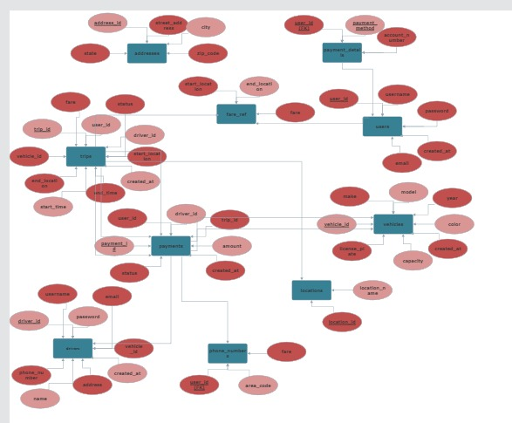

Slide 10
Relational Schema

Slide 11
Users (user_id, username,password, email, phone_number, address, payment_details, created_at)
Drivers (driver_id, username, password, email, phone_number, name, address, vehicle_id, created_at)
Current_location (driver_id, location)
Fare_ref (start_location, end_location, fare)
Payments (payment_id, user_id, driver_id, trip_id, amount, status, created_at)
Ratings (rating_id, user_id, driver_id, trip_id, rating, comments, created_at)
Trips (trip_id, user_id, driver_id, vehicle_id, start_location, end_location, start_time, end_time, fare, status, created_at)

Slide 12
Tables Used

Slide 13
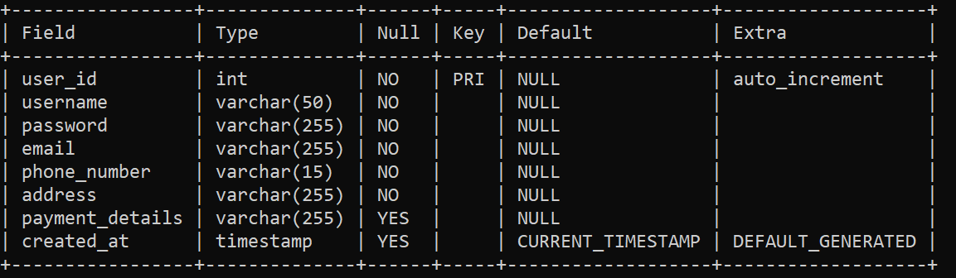
Users Table:

Slide 14
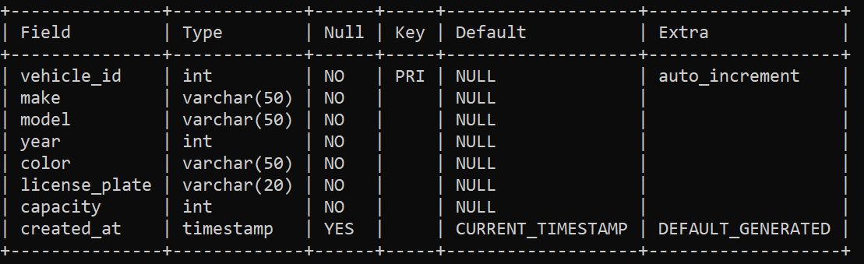
Vehicles Table:

Slide 15
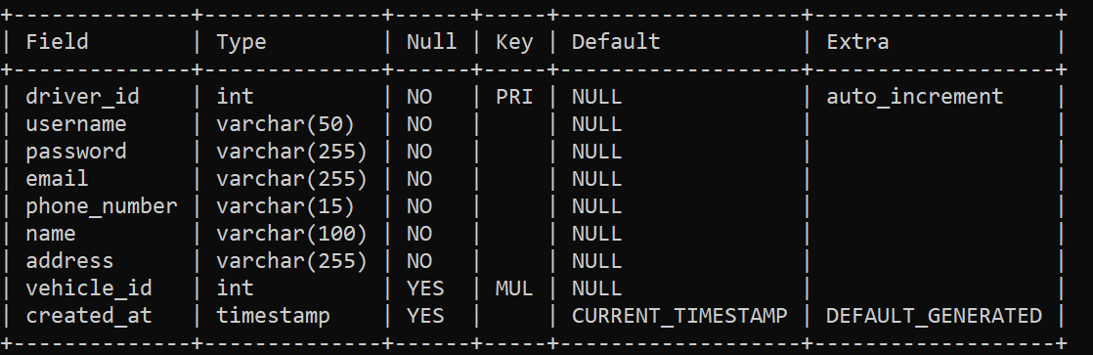
Drivers Table:

Slide 16
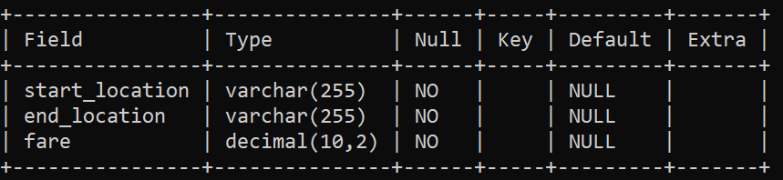
Fare_ref Table:

Slide 17
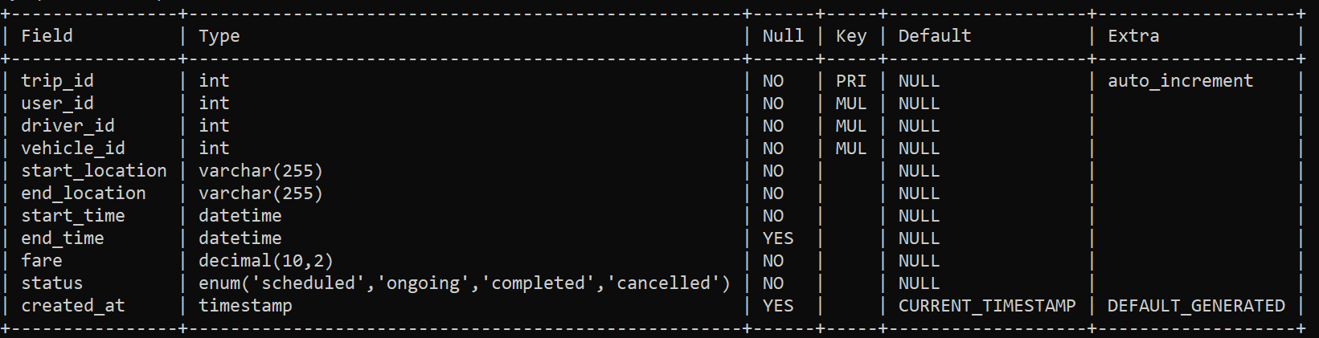
Trips Table:

Slide 18
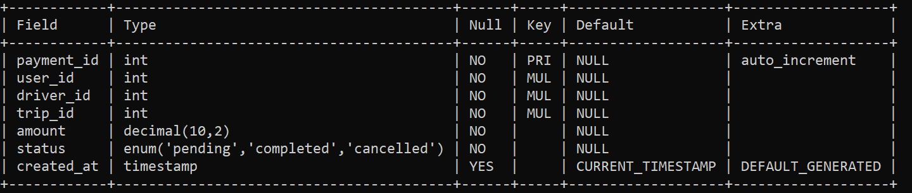
Payments Table:

Slide 19
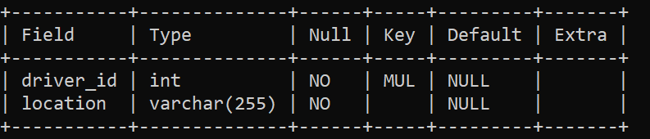
Current_location Table:

Slide 20
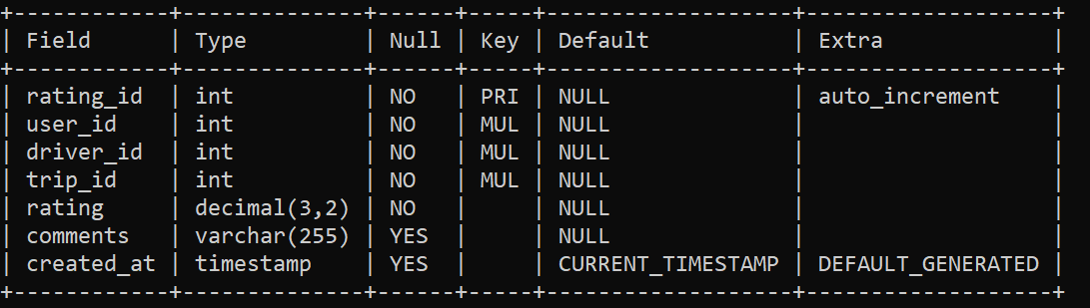
Ratings Table:

